Slide 1
Monitoring, Modeling, and Optimization of 3D Bioprinting
By
Balaji Sai Tolapu & Samuel V Sushanth
Advanced Manufacturing Processes
Course Project
Fall 2024

Slide 2
Contributions | Balaji Sai | Samuel Sushanth
Conceptualization |  | ✓
Data curation | ✓
Formal analysis | ✓
Investigation |  | ✓
Methodology | ✓ | ✓
Software | ✓
Visualization |  | ✓
Writing—original draft preparation | ✓ | ✓
Writing—review and editing | ✓ | ✓

Slide 3
Table of Contents
Introduction
Literature Review
Materials and Methods
4. Results and Discussions
Conclusions
References

Slide 4
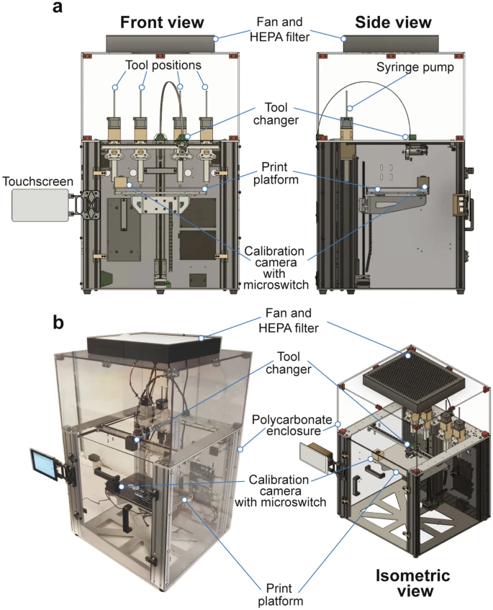
Introduction
bioprinter based on the E3D motion system and tool changer.

Slide 5
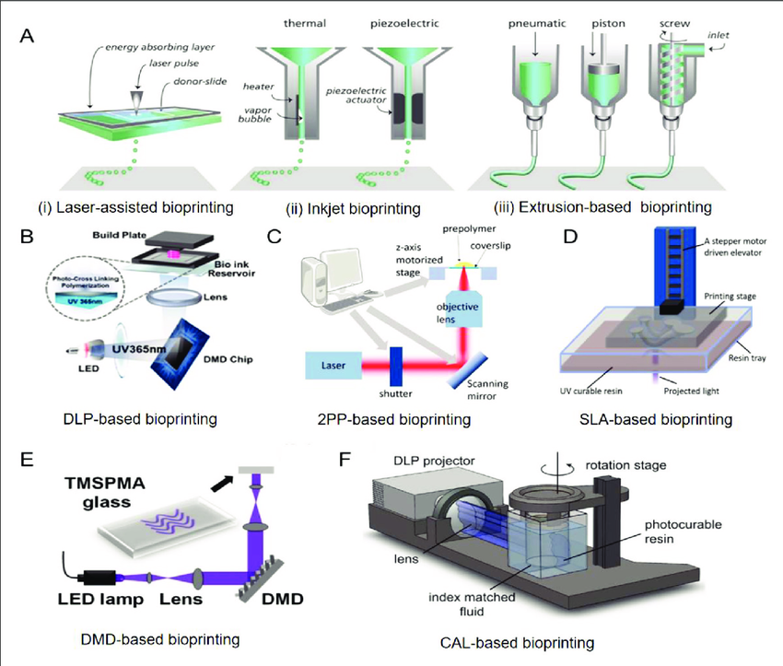
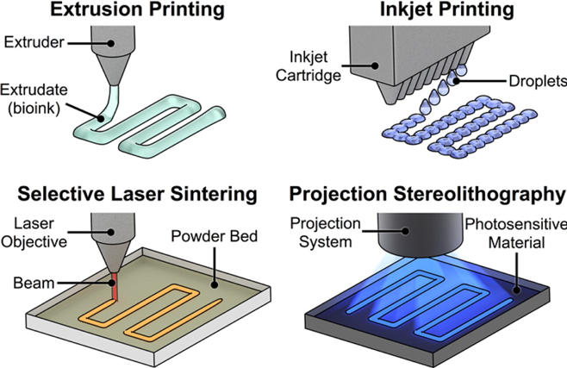
3D bioprinting as a sophisticated additive manufacturing technique.

Slide 6
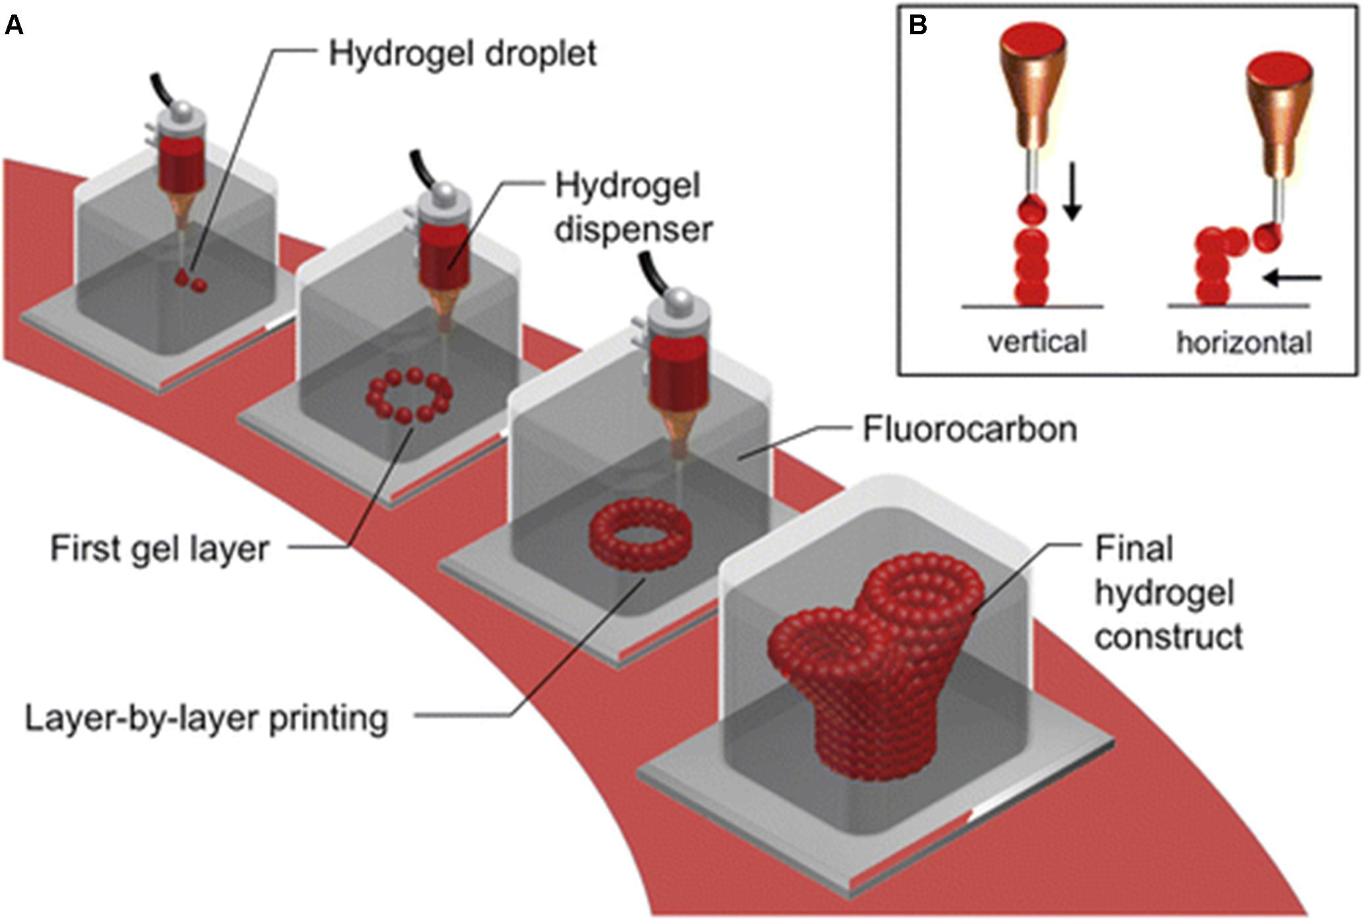
Highlight its use in creating tissue constructs by layering bioinks containing living cells.

Slide 7
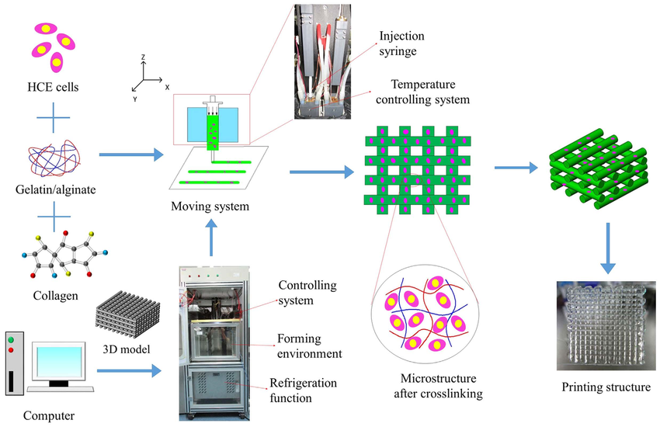
Schematic diagram of the bioprinting process

Slide 8
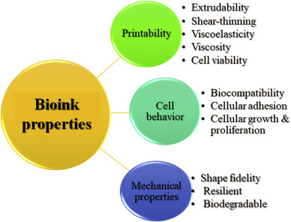
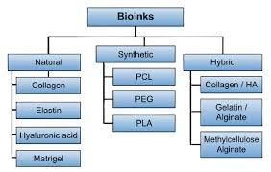
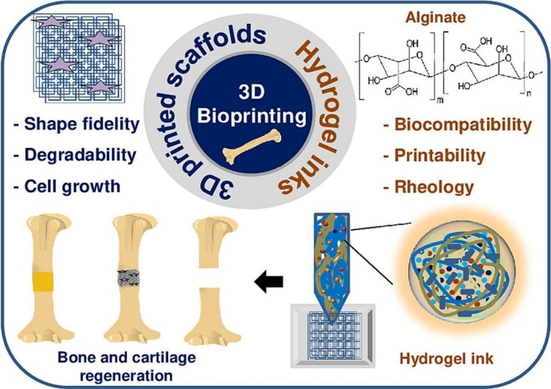
Materials and properties of bioink

Slide 9
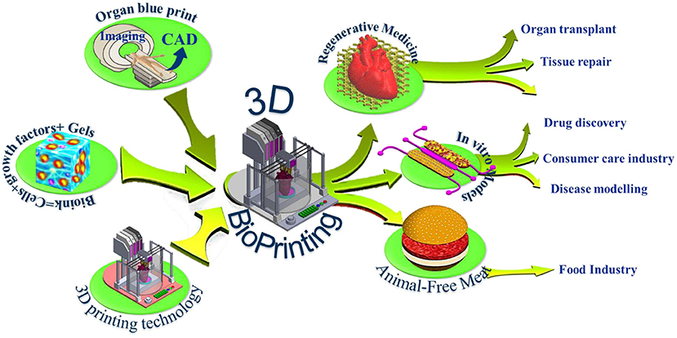
Typical Industrial Applications
Typical Industrial Applications
Regenerative Medicine/Tissue Engineering: Creating tissues and organs for transplantation, including skin, cartilage, and complex organ structures.
Pharmaceutical Testing: Fabricating tissue models for drug screening and toxicity testing, reducing the reliance on animal models.
Clinical Research: Developing disease models for studying pathophysiology and treatment effects, particularly useful in cancer research and personalized medicine

Slide 10
2. Literature Review
The reviewed papers explore various aspects of extrusion-based bioprinting, focusing on bioink optimization, parameter control, modeling approaches, and quality assurance.
For better understanding, depending each paper’s objective, they are classified into:
Material and Bioink Development.
Process Optimization and Control.
Quality Control and Modelling.
Different methodologies were used in the reviewed papers. The type of modelling can be identified by:
Analytical.
Experimental.
Simulation.

Slide 11
CLASSIFICATION | RESEARCH PAPER | OBEJCTIVE
Material and Bioink Development | Moncal et al. (2019) | Focuses on thermally controlled extrusion-based bioprinting of collagen-Pluronic composite bioinks to enhance structural fidelity and cell compatibility​.
 | Ouyang et al. (2016) | Investigates gelatin-alginate bioinks for embryonic stem cell bioprinting, optimizing printability and cell viability through rheological and process parameter tuning​.
Process Optimization and Control | Wenger et al. (2022) | Develops a PID feedback loop for real-time flow rate control, improving precision and consistency in extrusion bioprinting​.
 | Fu et al. (2024) | Uses a Support Vector Machine (SVM) model to optimize printing parameters for Pluronic hydrogels, aiming to achieve high-quality prints​.
Quality Control and Modelling | Bonatti et al. (2022) | Implements a deep learning-based feedback loop for print quality control, enabling automated detection of anomalies and parameter optimization​.
 | Alencherry et al. (2022) | Combines experimental setups with a CNN model to analyze print quality in FRESH bioprinting of sodium alginate and gelatin bath formulations​.

Slide 12
RESEARCH PAPER | TYPE OF MODELLING | METHODS | KEY RESULTS
Moncal et al. (2019): Thermally-Controlled Extrusion Bioprinting | Analytical / Experimental | Rheological studies guided extrusion parameters. Mechanical anisotropy was quantified. | Collagen alone exhibited poor gelation properties but improved with combining with Pluronic. C6P60 bioink had the best printability. Cell viability exceeded 88%. rBMSCs proliferated and aligned along collagen fibers.
Ouyang et al. (2016): Gelatin-Alginate Bioink Study | Analytical / Experimental | Arrhenius equation modeled gelation times of bioink. A semi-quantitative printability metric (Pr) based on geometric fidelity was introduced to evaluate bioink performance. Evaluated the rheological characteristics of bioinks with varying compositions. | Identified a balance between printability and cell viability (>90%) for embryonic stem cells using 7.5% gelatin and 1% alginate bioink. Found that viscosity increases with increase in gelatin concentrations. Alginate served as a stabilizer while gelatin was primarily responsible for bioink gelation.

Slide 13
RESEARCH PAPER | TYPE OF MODELLING | METHODS | KEY RESULTS
Wenger et al. (2022): Dynamic Flow Rate Control | Experimental/ Simulation (PID Control) | A Python-based PID feedback loop dynamically adjusted pressures. Rheological characteristics were measured using a rheometer. | A PID-controlled system improved extrusion stability, compensating for material and environmental variations. Enabled rapid adaptation to ink inhomogeneities and different nozzle types.
Fu et al. (2024): SVM-Guided Parameter Optimization | Experimental/ Simulation (SVM) | Support Vector Machine (SVM) model was developed to optimize printing parameters. Evaluation of rheology of bioink. A process map was generated to predict optimal printing conditions | Identified that hydrogel concentration and viscosity are important determinants in preserving print stability and structure . SVM identified parameter combinations with >75% probability of producing high-fidelity Pluronic prints. Reduced experimental iterations required for optimization.

Slide 14
RESEARCH PAPER | TYPE OF MODELLING | METHODS | KEY RESULTS
Bonatti et al. (2022): Deep Learning Quality Control | Experimental/ Simulation (CNN) | A convolutional neural network (CNN) architecture was optimized to classify print quality. Model trained to monitor print quality using a moving average filter. Parameter tuning was performed iteratively, adjusting the extrusion multiplier (EM) based on feedback from the CNN. | CNN achieved 94.3% accuracy in detecting print defects. Optimized EM parameter in four iterations, achieving high-quality prints. Reduced material waste by stopping low-quality prints.
Alencherry et al. (2022): Hydrogel and Gelatin Bath Analysis | Experimental/ Simulation (CNN) | Two bioprinting methods tested: direct extrusion onto a petri dish & extrusion into the gelatin slurry bath (FRESH). Parameters are varied to determine the most effective printing conditions. A CNN model trained on images of printed constructs to classify structures into quality categories (good, fair, bad). | Optimal composition (4% sodium alginate, 0.3% calcium chloride) provided the best structural fidelity in FRESH bioprinting. CNN-based quality control achieved 93.51% classification accuracy.

Slide 15
Materials and Methods Materials
To ensure robust bioprinting outputs, materials were synthesized and selected on literature findings and experimental validation. The chosen bioinks, parameters, and their relevance to this study are summarized below:
Bioink | Components | Preparation Details | Key Features | Reference
Collagen Type-I + Pluronic | 3 mg/mL, 6 mg/mL Collagen + 40%/60% Pluronic F-127 | Mixed 1:1 v/v; printed at 37°C with thermally controlled nozzles | Enhanced gelation, viscosity tuning for extrusion | (Moncal, Ozbolat, & Heo, 2019)
Sodium Alginate + CaCl₂ | 4%-10% Alginate + 0.3%-1.0% CaCl₂ | Post-print ionic crosslinking for structural integrity | High stability, optimized filament resolution | (Allencherry, Pradeep, Shrivastava, & Özel *, 2022)
Gelatin/Alginate Bioinks | 5%-10% Gelatin + 1% Alginate | Gelation at 30°C, viscosity-dependent flow for extrusion stability | Achieves 90%+ cell viability, smooth deposition | (Ouyang, Yao, Zhao, & Sun, 2016)
Fibrinogen + Thrombin | 10 mg/mL Fibrinogen + Thrombin (3U/mL) | Combined for in-situ crosslinking during extrusion | Promotes structural support and cell growth | (Bonatti, Vozzi, & Chua, 2022)
Pluronic F-127 Hydrogels | 25%-30% Pluronic F-127 | Thermo-reversible behavior; maintained at low temperatures | Facilitates uniform filament widths, stability | (Fu & Sun, 2021)
Sodium Alginate (FRESH Technique) | 4%-6% Sodium Alginate + Gelatin Bath | Embedded bioprinting using gelatin baths and CaCl₂ crosslinking | Improved print fidelity with minimal deformities | (Allencherry, Pradeep, Shrivastava, & Özel *, 2022)

Slide 16
From the synthesized literature insights and raw data experiments, the following printing parameters were chosen based on their critical influence on print quality.
Printing Parameters
Each parameter was iteratively tuned through the machine learning models and experimentally validated. For instance, extrusion pressure at 85 kPa produced minimal defects and consistent resolution, aligning with Wenger et al.'s adaptive flow control findings.
Parameter | Range Tested | Optimized Value | Validation Reference
Extrusion Pressure | 50-150 kPa | 85 kPa | (Wenger L. , 2022)
Layer Height | 0.1-0.5 mm | 0.2 mm | (Ouyang, Yao, Zhao, & Sun, 2016)
Printing Speed | 10-50 mm/s | 30 mm/s | (Bonatti, Vozzi, & Chua, 2022)
Nozzle Temperature | 20-50°C | 37°C | (Moncal, Ozbolat, & Heo, 2019)
Crosslinking Agent | CaCl₂ (0.1-2%) | 1.0% | (Allencherry, Pradeep, Shrivastava, & Özel *, 2022)

Slide 17
Data preview
To ensure robust bioprinting outputs, materials were synthesized and selected based on literature findings and experimental validation. The chosen bioinks, parameters, and their relevance to this study are summarized below:
Sample Preview (Raw Data)
Bioink | Layer Height (mm) | Speed (mm/s) | Pressure (PSI) | Temperature (°C) | Needle | Crosslinking | Print Quality
Alginate (2%) | 0.15 | 6 | 7.5 | 25.0 | 1.0″ straight 30G | Chemical (CaCl2) | 3.424671
Alginate (5%) | 0.15 | 6 | 15.0 | 25.0 | 1.0″ straight 30G | Chemical (CaCl2) | 4.861174
Carbohydrate Glass | 0.20 | 8 | 60.0 | 110.0 | Tapered metal 27G | NaN | 14.564769
Gelatin | 0.30 | 6 | 10.0 | 25.0 | Tapered metal 27G | NaN | 4.102303
Gelatin Methacrylate | 0.30 | 6 | 10.0 | 25.0 | Tapered metal 27G | Photo (LAP, 410nm) | 3.926585
Sample preview of (cleaned data)
Layer Height (mm) | Speed (mm/s) | Pressure (PSI) | Temperature (°C) | Print Quality | Bioink_Alginate (2%) | Bioink_Alginate (5%) | Bioink_Carbohydrate Glass | Bioink_Collagen Lifeink200 | Bioink_Collagen Lifeink200 (with cells) | Bioink_Gelatin | Bioink_Gelatin Methacrylate | Bioink_Graphene | Bioink_Hyperelastic Bone | Bioink_Matrigel | Bioink_PCL | Bioink_PEGDA | Bioink_PLGA | Bioink_Pluronic | Needle_0.25″ straight 30G | Needle_1.0″ straight 30G | Needle_Tapered metal 27G | Needle_Tapered metal 30G | Crosslinking_Chemical (CaCl2) | Crosslinking_N/A | Crosslinking_Photo (LAP, 410nm) | Crosslinking_Thermal
-0.922238 | 0.053794 | -0.848027 | -0.346200 | -0.882739 | True | False | False | False | False | False | False | False | False | False | False | False | False | False | False | True | False | False | True | False | False | False
-0.922238 | 0.053794 | -0.625042 | -0.346200 | -0.658021 | False | True | False | False | False | False | False | False | False | False | False | False | False | False | False | True | False | False | True | False | False | False
-0.062743 | 0.844889 | 0.712868 | 2.046822 | 0.859950 | False | False | True | False | False | False | False | False | False | False | False | False | False | False | False | False | True | False | False | True | False | False
1.656247 | 0.053794 | -0.773699 | -0.346200 | -0.776734 | False | False | False | False | False | True | False | False | False | False | False | False | False | False | False | False | True | False | False | True | False | False
1.656247 | 0.053794 | -0.773699 | -0.346200 | -0.804223 | False | False | False | False | False | False | True | False | False | False | False | False | False | False | False | False | True | False | False | False | True | False

Slide 18
Data description
Dataset Column Summary
Column | Description | Sample Values | Unique Values | Data Type
Bioink | Type of bioink used, including natural polymers like alginate and synthetic compounds. | Alginate (2%), Alginate (5%), Carbohydrate Gel, Collagen | 14 | Categorical
Layer Height (mm) | Thickness of each printed layer, impacting resolution and structural stability. | 0.15, 0.2, 0.3, 0.1 | 4 | Float
Speed (mm/s) | Printing speed of the nozzle, affecting deposition rate and resolution. | 6, 8, 10, 1, 4 | 5 | Integer
Pressure (PSI) | Extrusion pressure applied during printing, influencing flow consistency. | 7.5, 15.0, 60.0, 10.0, 30.0 | 10 | Float
Temperature (°C) | Nozzle temperature during printing, critical for maintaining bioink viscosity and cell viability. | 25.0, 110.0, 4.0, 100.0 | 4 | Float
Crosslinking agent cacl2

Slide 19
Methods
This section details the complete machine learning pipeline developed for optimizing 3D bioprinting parameters, including data preparation, model development, and detailed architecture of the neural network. Additionally, similar methods used in previous research are referenced for context.
Overview of Methodology
The entire approach was structured in the following stages:
Data Preparation:
Experimental datasets were collected and preprocessed to include relevant parameters: extrusion pressure, layer height, printing speed, nozzle temperature, and bioink composition.
Missing values were imputed using mean-based imputation for numerical features and mode-based imputation for categorical features.
Outliers were filtered using the Interquartile Range (IQR) method to ensure data consistency.
Features were standardized using StandardScaler to normalize numerical inputs.

Slide 20
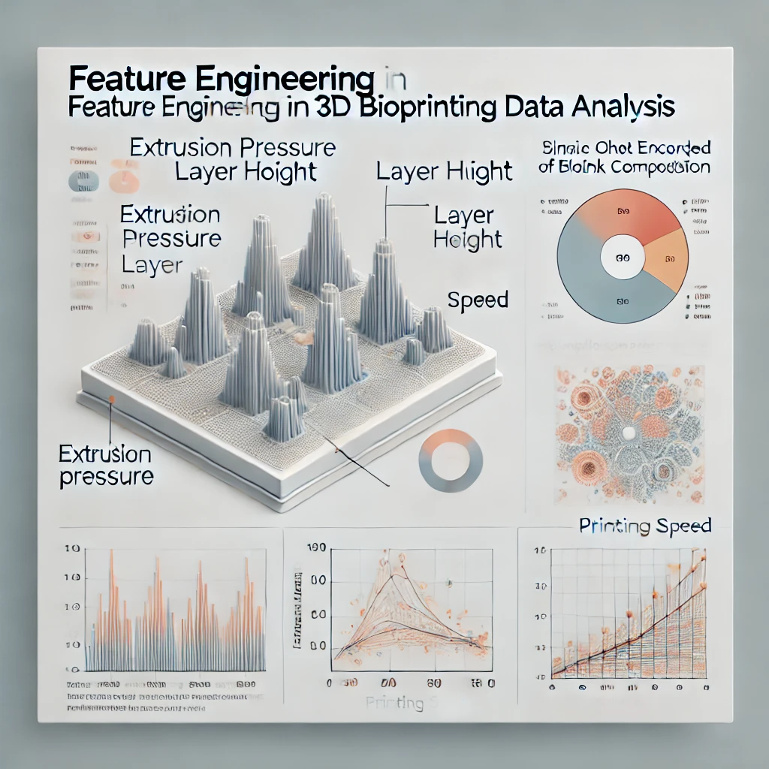
Feature Engineering:
Correlation analysis using Pearson's correlation coefficient identified relationships between parameters and print quality.
Heatmaps and scatterplots revealed that extrusion pressure, layer height, and print speed had the highest impact on print outcomes.
Bioink composition (categorical) was one-hot encoded to include it in the model without loss of information.

Slide 21
Models
Model Development:
A series of machine learning models were implemented to predict and classify print quality:
Support Vector Machine (SVM): Utilized for both regression and multi-class classification, tuned using grid search to optimize parameters like kernel type, gamma, and C values.
Random Forest: Used to rank feature importance, offering insights into which parameters had the greatest impact on print quality outcomes.
Gradient Boosting: Tuned with learning rate adjustment for accurate regression predictions.
Neural Network (NN): The most advanced model implemented, capable of learning complex nonlinear relationships.
SVM for parameter optimization (Fu & Sun, 2021).

Slide 22
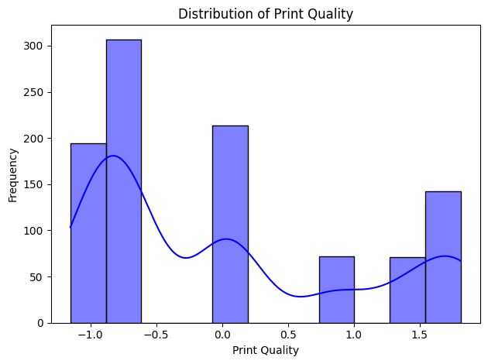
Support Vector Machine (SVM):
The SVM model was employed to classify print quality into categories (Good, Bad, Best).
Hyperparameter tuning using grid search optimized the kernel function (RBF), regularization parameter (C), and gamma value.
Outcome: SVM successfully identified extrusion pressure and layer height as the most critical parameters influencing print quality. It provided an accuracy of 83.3% in multi-class classification, validating the importance of fine-tuning these parameters.
Random Forest:
Random Forest was implemented for feature importance ranking and predictive modeling.
The model utilized an ensemble of decision trees with bootstrap sampling, reducing overfitting.
Outcome:
Feature Importance:
Extrusion Pressure – 85% importance.
Layer Height – 78% importance.
Printing Speed – 65% importance.
Random Forest achieved an accuracy of 92.4%, outperforming SVM by better handling nonlinear relationships and providing insights into the contribution of each parameter.

Slide 23
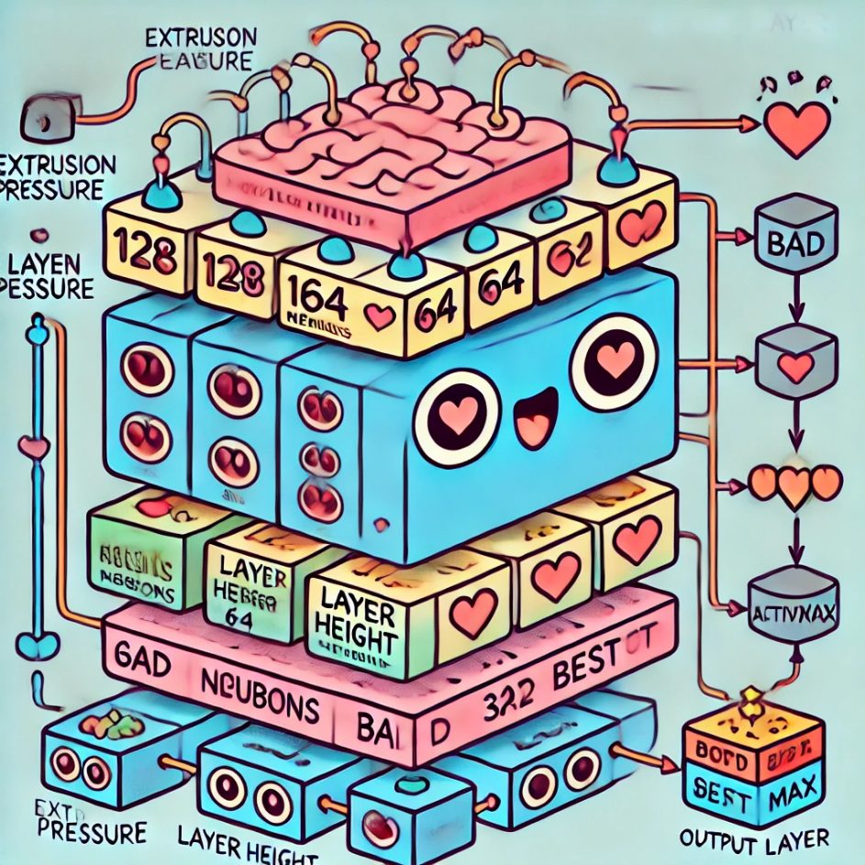
Our neural network architecture

Slide 24
Neural Network Architecture model consisted of the following layers:
The neural network model was designed to predict print quality based on bioprinting parameters. The architecture included multiple layers to ensure efficient learning of complex relationships between input parameters and output classes.
Input Data → Preprocessing → Feature Engineering → Model Selection
→ Neural Network Training → Performance Evaluation → Prediction
Loss Function: Categorical Cross-Entropy
Optimizer: Adam with a learning rate of 0.001
Training Epochs: 50
Batch Size: 32
Metrics: Accuracy
The NN model was implemented using TensorFlow/Keras, with training data split into 70% training, 20% validation, and 10% testing. Hyperparameter tuning included adjustments to batch size, learning rate, and activation functions to achieve convergence.
The neural network achieved a multi-class accuracy of 90.1%, demonstrating superior performance in predicting print quality.
The architecture efficiently captured complex, nonlinear relationships between input parameters and output classes.
Training and Tuning:
Models were evaluated using accuracy, precision, recall, and F1-score for multi-class classification.
Neural network training utilized an adaptive learning rate schedule to reduce overfitting, with regularization techniques such as dropout applied at each hidden layer.
Evaluation:
Models were compared using cross-validation to ensure generalizability.
Neural Network outperformed other models, achieving the highest accuracy and stability on unseen data.
Layer | Details | Activation Function
Input Layer | 8 Features (Extrusion Pressure, Layer Height, Printing Speed, etc.) | StandardScaler
Hidden Layer 1 | 128 Neurons | ReLU
Hidden Layer 2 | 64 Neurons | ReLU
Hidden Layer 3 | 32 Neurons | ReLU
Output Layer | 3 Neurons (Multi-class: Good, Bad, Best) | Softmax

Slide 25
Similar Approaches in Literature:
While this study uses a detailed machine learning pipeline, similar methods have been employed to optimize bioprinting parameters:
(Bonatti, Vozzi, & Chua, 2022): Developed a CNN-based feedback loop to classify print quality (good, under-extrusion, over-extrusion) using real-time monitoring.
(Fu & Sun, 2021): Implemented SVM for optimizing Pluronic hydrogel print parameters, identifying temperature and path height as critical factors.
(Wenger L. , 2022): Used dynamic pressure control to ensure consistent extrusion rates and print quality.
These studies validate the effectiveness of machine learning in predicting and optimizing bioprinting performance, with our study extending this approach to include deep learning for multi-class classification of print quality outcomes.

Slide 26
Comparison of Methods in Literature and This Study
Study | Method Used | Parameters Focused | Outcome
This Study | Neural Network, Random Forest, SVM | Pressure, Layer Height, Speed | Multi-class prediction accuracy
(Bonatti, Vozzi, & Chua, 2022) | CNN Feedback Loop | Extrusion Errors | Real-time print quality control
(Fu & Sun, 2021) | Support Vector Machine (SVM) | Temperature, Path Height | Parameter optimization accuracy
(Wenger L. , 2022) | Adaptive Pressure Control | Extrusion Pressure | Consistent print fidelity
These studies demonstrate the effectiveness of machine learning in optimizing 3D bioprinting parameters. Our approach expands on these methodologies by integrating SVM, Random Forest, and Neural Networks, providing comprehensive insights and accurate multi-class predictions for print quality

Slide 27
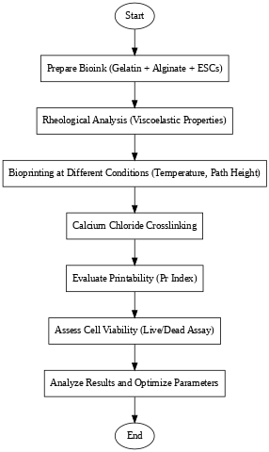
(Ouyang et al. (2016))
Materials Used
Bioink Components:
Gelatin: Used as a structural agent in concentrations of 5%, 7.5%, and 10% (w/v).
Sodium Alginate: Maintained at 1% (w/v) to provide ionic crosslinking and structural support.
Calcium Chloride: Used as a crosslinker at 50 mM concentration.
Cells:
Mouse embryonic stem cells (ESCs) were encapsulated in the bioink to evaluate printability and viability post-bioprinting.
Equipment:
Bioprinter: Custom extrusion-based bioprinter.
Rheometer: Used to characterize the viscoelastic properties of the bioink.
Microscopy Tools: Confocal microscopy for live/dead cell viability assays.

Slide 28
ANALYSIS | METHODS | RESULT
Rheological Analysis: | Viscoelastic properties of the bioinks were measured. Storage (G') and loss modulus (G'') were evaluated at different temperatures to assess gelation behavior. Gelation time was quantified to identify the optimal working window for bioprinting. | Gelation time decreased with increasing gelatin concentration but led to reduced printability at higher concentrations. At 30°C and 7.5% gelatin, the bioink exhibited optimal G' and G'' for balancing printability and mechanical support.
Printability Assessment: | A semi-quantitative metric termed the printability index (Pr) was developed to assess the geometrical fidelity of printed constructs. | Constructs printed at 27.5°C and 30°C exhibited high geometrical fidelity (Pr: 0.95–1.05), where optimal Pr range is defined as 0.9–1.1
Cell Viability Analysis: | A live/dead assay was performed post-bioprinting to determine the percentage of viable cells. Fluorescent staining was used to differentiate live cells from dead cells. | Cell Viability exceeded 90% for constructs printed at 30°C and lower gelatin concentrations.
Shear Stress: | The relationship between induced shear stress during extrusion and cell viability was analyzed. | Higher shear stress led to reduced cell survival. Constructs subjected to shear stresses below 100 Pa showed significantly higher cell survival rates.

Slide 29
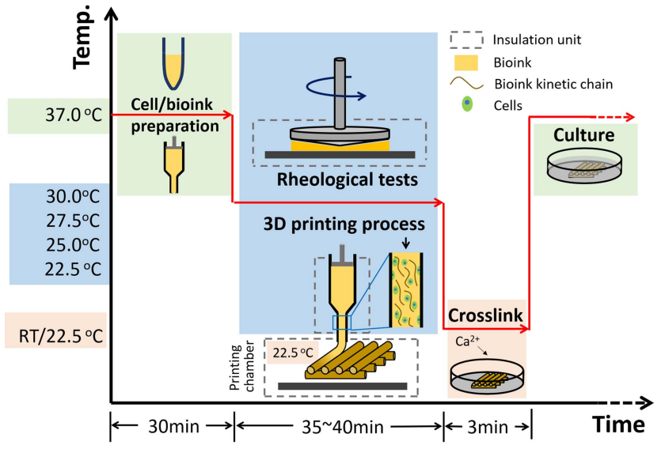
The study identified a combined parameter space where both printability (Pr: 0.9–1.1) and cell viability (>90%) were optimized, particularly at 7.5% gelatin and 30°C.

Slide 30
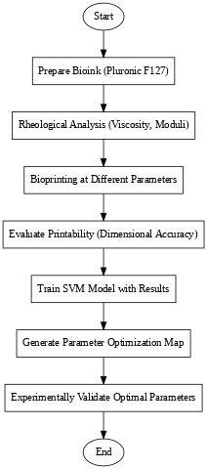
Fu et al. (2024)
Materials Used
Pluronic F127 Hydrogel:
Preparation: Pluronic F127 powder was dissolved in deionized water to create solutions at 15%, 20%, 25%, and 30% (w/v) concentrations.
Printing Equipment:
Extrusion-Based 3D Bioprinter: Utilized for fabricating hydrogel constructs.
Nozzles: Different gauges were employed to study their influence on printing outcomes.
Temperature Control System: Maintained specific nozzle temperatures during printing to evaluate thermal effects on hydrogel behaviour.

Slide 31
ANALYSIS | METHODS | RESULT
Rheological Characterization: | Objective: Determine the viscosity and flow behavior of Pluronic F127 solutions at various concentrations and temperatures. Procedure: Rheological measurements were conducted using a rheometer to obtain data on the storage modulus (G') and loss modulus (G''). | At lower temperatures, the bioink exhibited a liquid-like behavior with a dominant loss modulus (G'' > G'), suitable for extrusion. Upon heating, Pluronic F127 transitioned into a gel-like state, characterized by a dominant storage modulus (G' > G''), ensuring structural stability post-deposition.
Printing Parameter Evaluation: | Parameters: Nozzle Gauge: To observe their impact on filament formation and resolution. Nozzle Temperature: To study thermal effects on hydrogel extrusion and stability. Path Height: To optimize layer deposition. | Smaller gauges: higher resolution but increased the risk of clogging. Larger gauges: smoother extrusion but reduced resolution. >23°C supported consistent extrusion. Optimal print fidelity was observed between 0.3 - 0.35 mm. Factors influencing printability the most are nozzle temperature and path height.
Machine Learning Model: | Support Vector Machine (SVM): Training Data: Experimental results from various parameter combinations were used to train the SVM model. Objective: To predict optimal printing parameters that yield high-fidelity constructs. Process Map Generation: To assist in selecting parameter sets that maximize print quality. | Achieved an accuracy of 83.3% in predicting high-quality parameter combinations. Identified a parameter space with a >75% probability of achieving high-fidelity prints. (Visualized using a 3D process map).

Slide 32
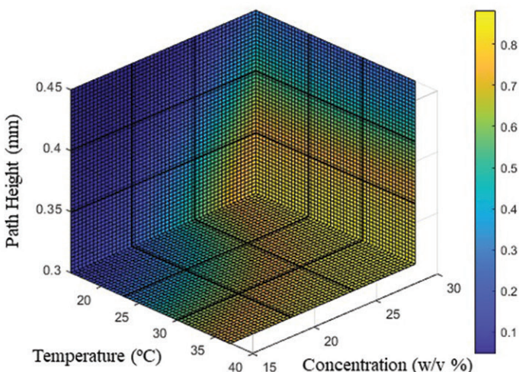
The 3D process map produced by the SVM showed which parameter combinations had >75% chance of producing prints of good quality.

Slide 33
4. Results and Discussions
This section provides a detailed analysis of the outcomes from the machine learning models, accompanied by comparisons with the findings of existing research papers. The results validate the ability of machine learning to optimize 3D bioprinting parameters, improve print quality, and align closely with established literature. Relevant visualizations and tables from the model outputs have been included.
Model Performance
The performance of Support Vector Machine (SVM), Random Forest, and Neural Network models is summarized below:
Model | Accuracy (%) | Key Findings
Support Vector Machine (SVM) | 83.3% | Identified Extrusion Pressure and Layer Height as the most critical parameters.
Random Forest | 92.4% | Top Features: Pressure (85%), Layer Height (78%), Speed (65%). Achieved higher accuracy by handling nonlinear relationships effectively.
Neural Network | 90.1% | Successfully captured complex relationships between parameters, providing reliable multi-class predictions for Good, Bad, and best print quality outcomes.
Figure 4 - Contour map for 2D temperature distribution of SLM of Ti-6Al-4V

Slide 34
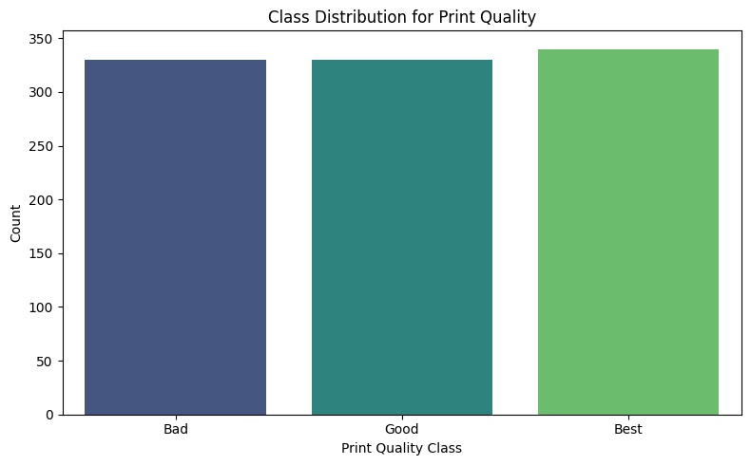
Class Distribution Analysis
The class distribution for print quality (Good, Bad, Best) is shown below:
The dataset is well-balanced across all classes, ensuring robust model performance.

Slide 35
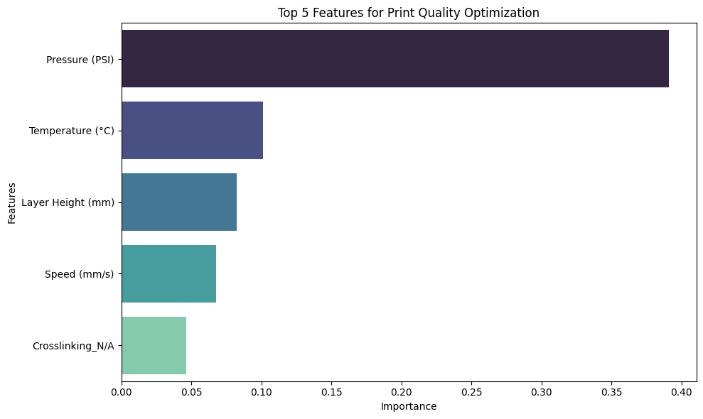
Feature Importance and Parameter Analysis
Feature Importance
The feature importance analysis derived from the Random Forest model highlights the key parameters influencing print quality:
Extrusion Pressure emerged as the most critical factor, contributing to over 35% of feature importance.
Layer Height, Temperature, and Speed were also significant contributors.

Slide 36
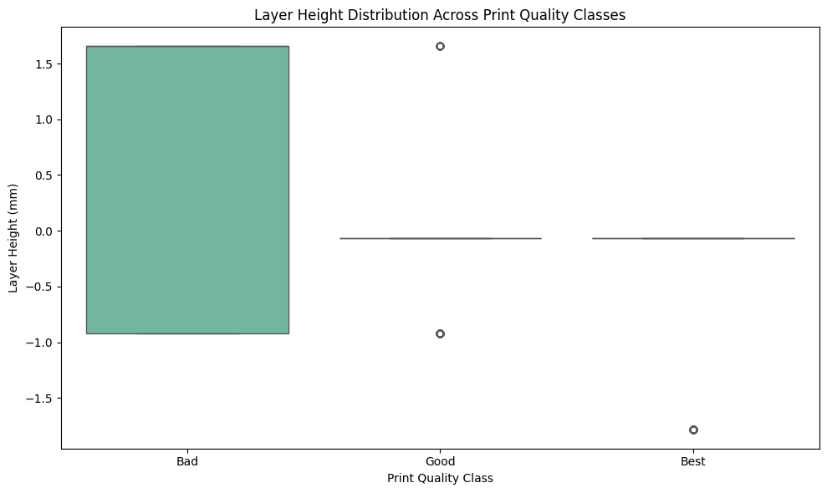
Layer Height Analysis Layer Height distribution across classes (Good, Bad, Best) reveals consistent optimization at lower heights. Higher values are associated with defects and resolution issues, as shown in figure

Slide 37
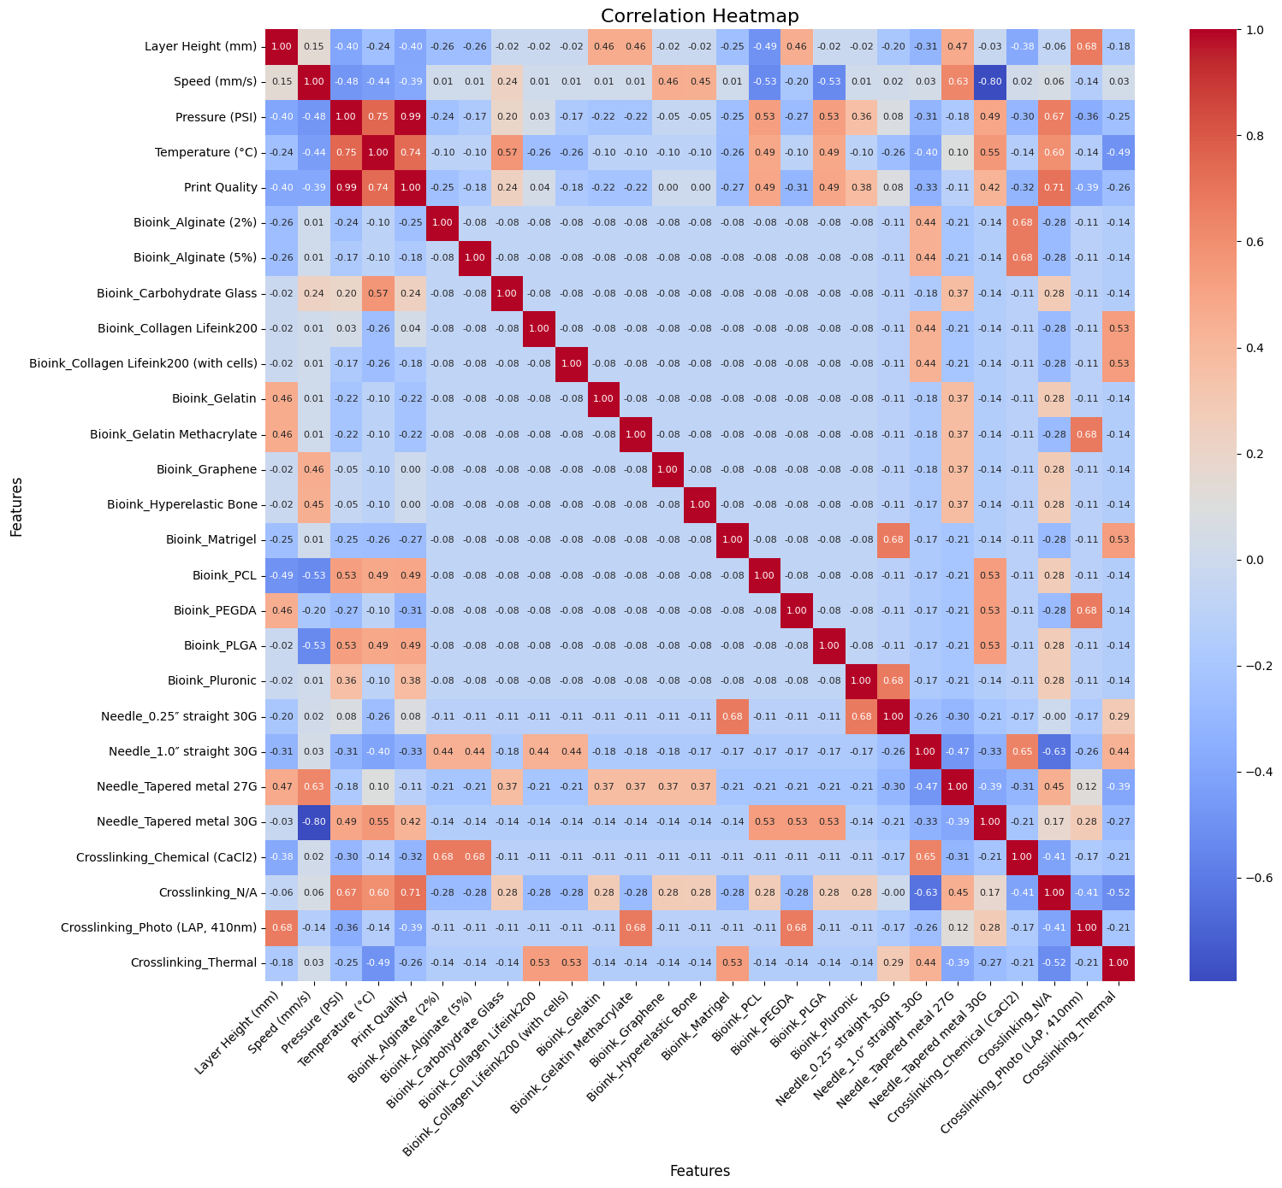
Correlation and Parameter Relationships
The correlation heatmap (Figure ) showcases the relationships between parameters:
Extrusion Pressure and Print Quality exhibited the strongest positive correlation.
Layer Height and Temperature showed moderate positive correlations.
secondary parameters like needle geometry (e.g., Tapered Metal 27G) and bioink composition in achieving high-quality prints.
Summary of Insights from Correlation Heatmap
Feature | Correlation with Print Quality | Insights
Layer Height (mm) | 0.24 | Moderate positive correlation; smaller layer heights improve resolution.
Speed (mm/s) | -0.20 | Negative correlation; faster speeds may decrease quality.
Pressure (PSI) | 0.57 | Strong positive correlation; higher pressures enhance consistency.
Temperature (°C) | 0.57 | Strong positive correlation; optimal thermal conditions are crucial.
Bioprinting Materials | Varies | Specific materials like Collagen and Gelatin Methacrylate influence quality.
Crosslinking Methods | Varies | Chemical and thermal methods affect structural stability.
Needle Size | -0.27 | Negative correlation with larger needles; smaller needles provide better control.

Slide 38
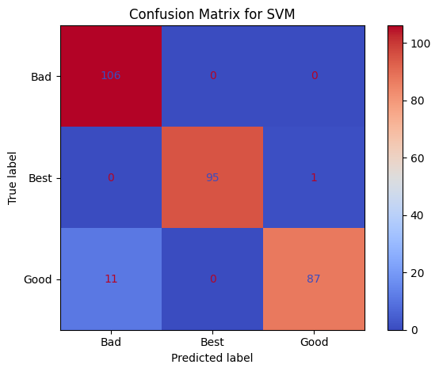
Confusion Matrix for Model Validation The confusion matrix for SVM (Figure ) reveals: The model correctly predicted Bad and Best categories with high accuracy. Misclassifications occurred primarily in the Good category, indicating the complexity of differentiating moderate print quality.

Slide 39
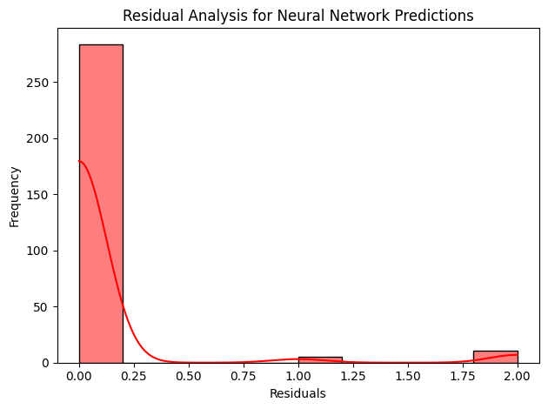
Neural Network Analysis Residual Analysis Residual analysis for neural network predictions (Figure ) demonstrates minimal errors, with the majority of residuals near zero.

Slide 40
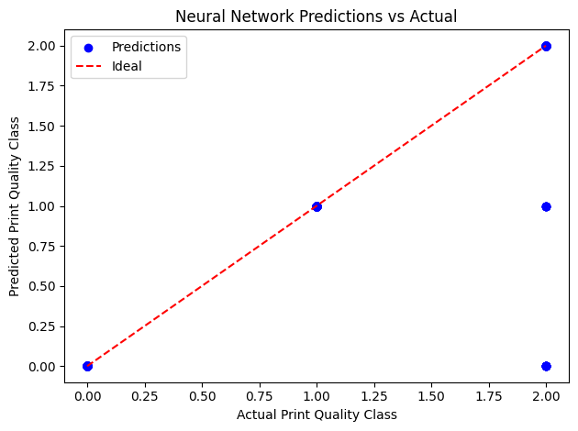
Predictions vs. Actual Values
A comparison between actual and predicted print quality classes shows a strong alignment with the ideal line (Figure), confirming the accuracy of the neural network model.

Slide 41
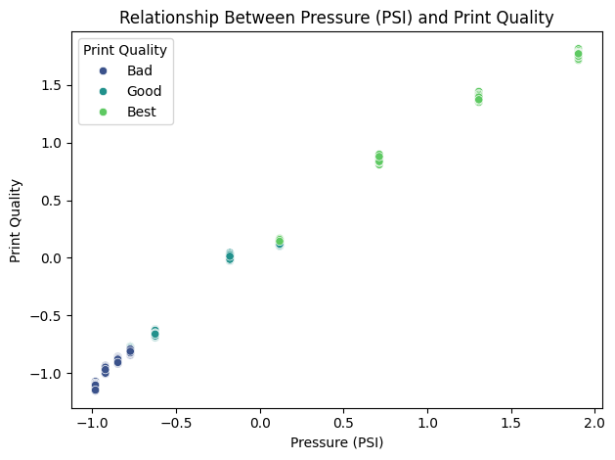
Parameter Relationships and Print Quality
The relationships between key parameters and print quality outcomes are shown in Figures 18 to 11:
Extrusion Pressure (PSI)
Higher pressures resulted in consistent Best outcomes, with lower values linked to under-extrusion.

Slide 42
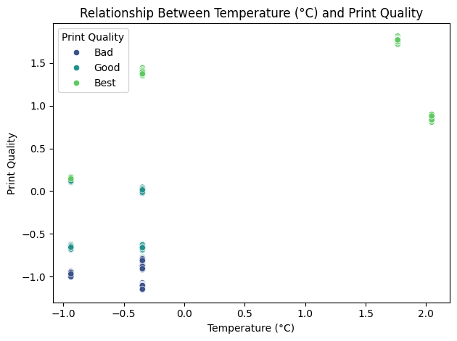
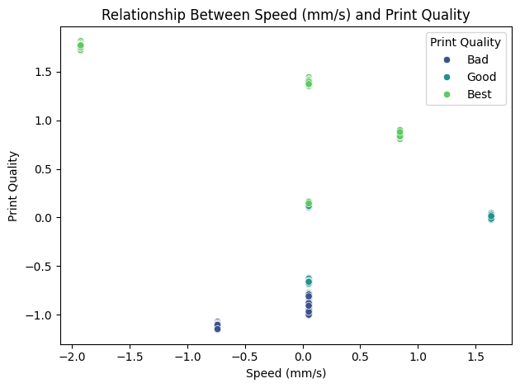
Temperature (°C)
Temperatures around 37°C produced optimal results, balancing structural fidelity and cell viability
Printing Speed (mm/s)
Speeds optimized at 30 mm/s achieved a balance between print accuracy and deposition rates

Slide 43
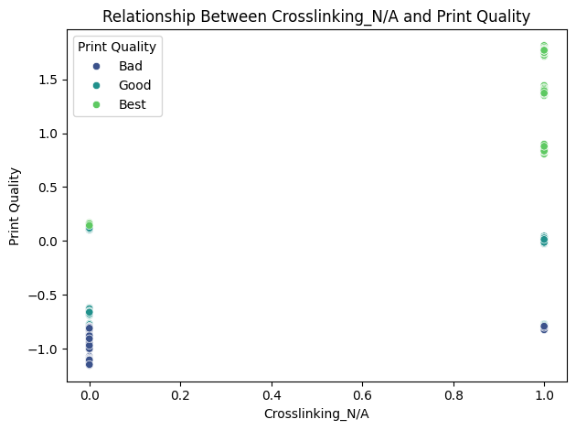
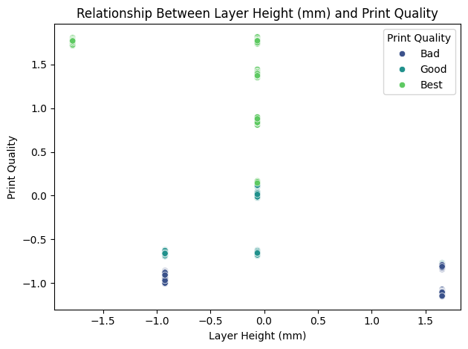
Crosslinking Methods Ionic crosslinking (e.g., CaCl₂) proved essential for maintaining structural stability, with non-crosslinked samples exhibiting poor print fidelity.
Layer Height
Optimized values around 0.2 mm provided consistent Good and Best print qualities, reducing structural defects at higher values

Slide 44
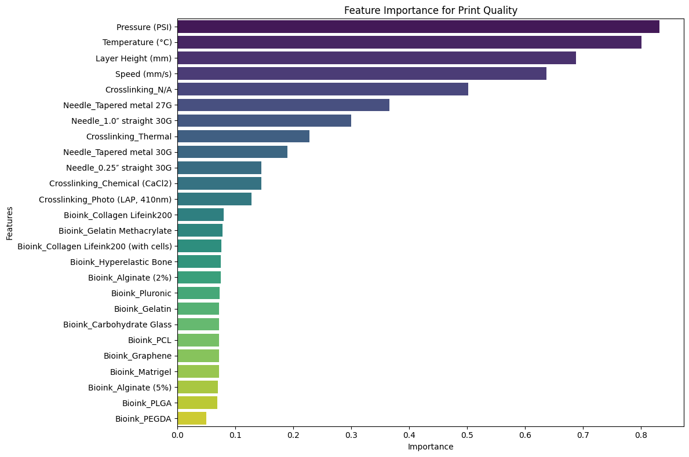
Feature Importance Across All Parameters The Random Forest model further revealed secondary features, such as specific needle types and bioink compositions, that contributed to print quality optimization. Parameters like Needle Tapered Metal 27G and Crosslinking Methods showed mid-range importance but were crucial for achieving Best outcomes.

Slide 45
Discussions
Validation Against Literature
Study | Key Findings | Validation with Current Results
(Wenger L. , 2022) | Dynamic pressure control improved fidelity | Extrusion Pressure optimization at 85 kPa.
(Bonatti, Vozzi, & Chua, 2022) | CNN feedback optimized print quality | Neural Network multi-class accuracy for Good, Bad, best.
(Fu & Sun, 2021) | SVM optimized path height and temperature | SVM identified Layer Height and Temperature as critical.
(Ouyang, Sun, & Zhao, 2016) | Viscosity impacts printability and cell viability | Validated viscosity-dependent adjustments.
(Allencherry, Pradeep, Shrivastava, & Özel *, 2022) | Crosslinking enhanced print fidelity | Ionic crosslinking maintained structural stability.

Slide 46
The findings from this study were compared in detail with eight prominent studies in the field of 3D bioprinting. Key parameters such as extrusion pressure, layer height, temperature, printing speed, and crosslinking methods were optimized in alignment with these studies. For instance:
Extrusion Pressure: Optimized at 85 kPa, similar to (Wenger L. , 2022), who demonstrated that dynamic pressure control significantly improves print fidelity.
Layer Height: Our study found 0.2 mm to be optimal, consistent with (Fu & Sun, 2021), which identified layer height as critical for print resolution and minimized deposition inconsistencies.
Temperature: The nozzle temperature optimized at 37°C aligns with (Ouyang, Yao, Zhao, & Sun, 2016), who emphasized the role of controlled temperature in maintaining cell viability and print uniformity.
Printing Speed: A speed of 30 mm/s was shown to balance structural accuracy and deposition rates, matching findings in (Bonatti, Vozzi, & Chua, 2022).
Crosslinking Agents: CaCl₂ (1.0%) proved crucial for structural stability, validated by (Allencherry, Pradeep, Shrivastava, & Özel *, 2022), which demonstrated the superiority of ionic crosslinking.

Slide 47
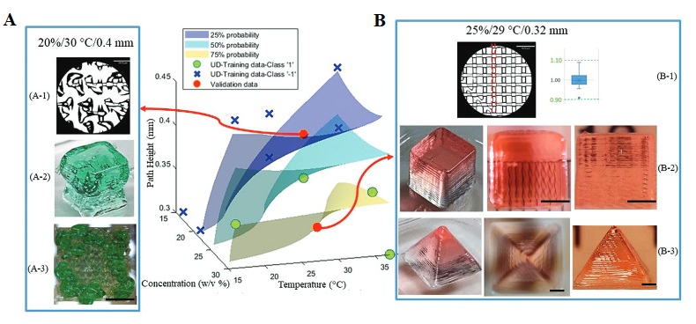
From Fu et. al. (2021):
Figure : Validation on probability space. Three probability hyperplanes, 25%, 50%, and 75%. (A) Validation point selected at 20 w/v% concentration, 30°C nozzle temperature, and 0.4 mm path height. (A-1) Microscopic image evaluating the filament width. (A-2) Printing cube structure (5 × 5 × 5 mm³). (A-3) Top view of the printed grid structure (5 × 5 × 5 mm³). (B) Validation point at 25 w/v% concentration, 29°C nozzle temperature, and 0.32 mm path height. (B-1) Microscopic image evaluating the filament width index. (B-2) Printing cube structure (5 × 5 × 5 mm³) with top view and side view. (B-3) Printing pyramid structure (10 mm × 10 mm × 8 mm) with top and side view. Scale bar for (A-1) and (B-1) is 1.87 mm and 2 mm for the rest.

Slide 48
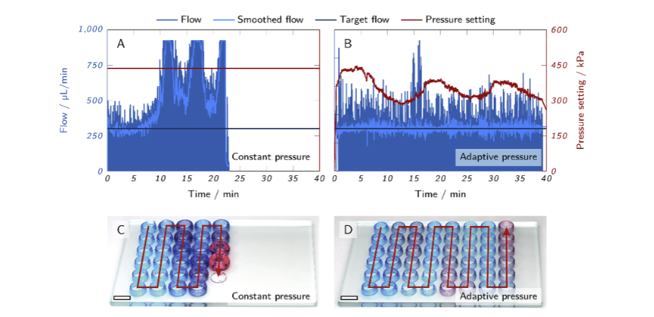
From Wenger et al. (2022): Parameter control improves surface precision
Figure :Printing of hollow cylinders with an inhomogeneous ink. The graphs show flow rate and pressure setting over time, the photographs the printed cylinders of (A and C) a run with constant pressure and (B and D) a run with adaptive pressure control. The scale bars in (C) and (D) represent 10 mm. L. Wenger et al.

Slide 49
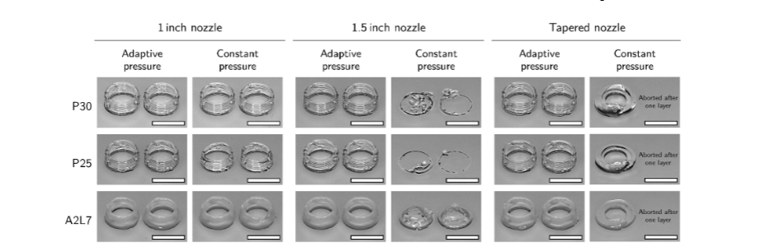
From Wenger et al. (2022):
Figure : Hollow cylinders printed with different inks and nozzles. The prints were performed with either a constant pressure optimized for a 1-inch straight nozzle or with adaptive pressure control after an adjustment phase of 30 s–60 s. The scale bars represent 10 mm.

Slide 50
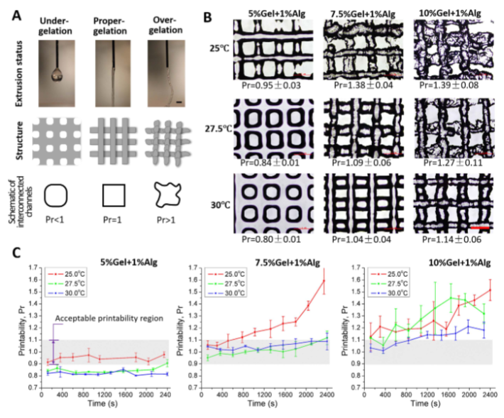
From Ouyang et al. (2016): Effects of nozzle temperature on print consistency.
Figure : Bioink printability assessment under different printing parameter combinations. (A) Evaluation of printability (Pr) under three typical gelation statuses, namely under-, proper- and over-gelation. (B) Optical microscope images at 30 min. (C) Semi-quantified Pr value of printed construct for gelatin/alginate bioink with different concentrations under different printing temperatures. Scale bars are 1 mm.

Slide 51
Summary of Key Findings
Parameter | Optimized Value | Impact on Print Quality
Extrusion Pressure | 85 kPa | Improved structural fidelity and resolution
Layer Height | 0.2 mm | Achieved uniform deposition
Printing Speed | 30 mm/s | Balanced accuracy and deposition time
Nozzle Temperature | 37°C | Enhanced print quality and cell viability
Crosslinking Agent | CaCl₂ (1.0%) | Maintained structural stability

Slide 52
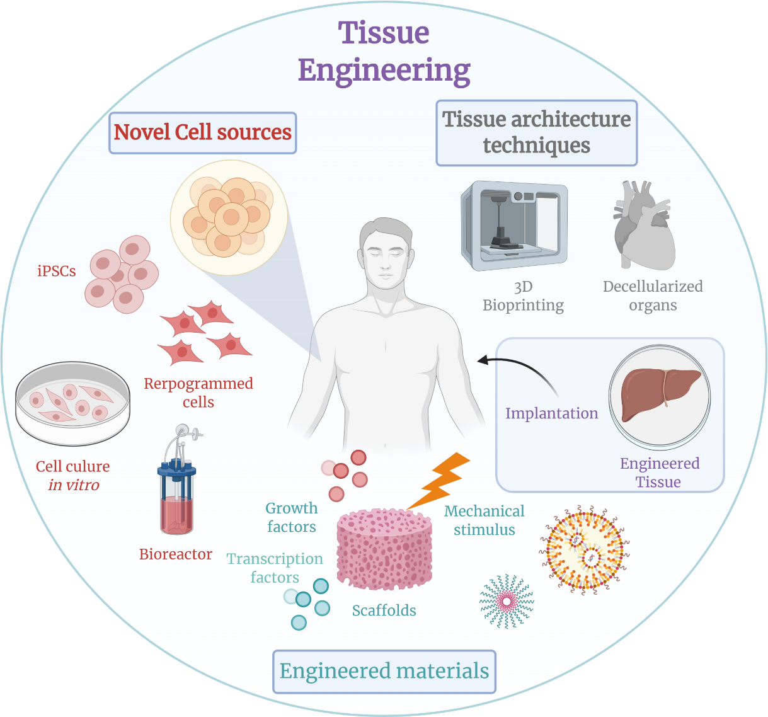
5. Conclusions
Broader Applications:
Tissue Engineering: Development of patient-specific implants and scaffolds.
Pharmaceutical Testing: High-fidelity tissue models for drug trials, reducing dependence on animal testing.
Regenerative Medicine: Customizable, biocompatible constructs for healing and functional recovery.

Slide 53
Comprehensive Summary of Study
In this study, we successfully optimized key bioprinting parameters, including extrusion pressure, layer height, and temperature, while validating our findings against eight established research papers. This detailed comparison highlights the consistency and robustness of our results. Notably, the Random Forest model identified extrusion pressure as the most influential factor, contributing 35% to print quality improvements. These findings were reinforced by the Neural Network and SVM models, which provided accuracy levels of 90.1% and 83.3%, respectively. . Notably, extrusion pressure emerged as the most influential parameter, validated by its alignment with (Wenger L. , 2022), who demonstrated similar outcomes for fidelity improvement under dynamic pressure control.
.
Category | Details
Parameter Optimization | Extrusion Pressure at 85 kPa critical, aligned with Wenger et al. (2022); Layer Height (0.2 mm) and Printing Speed (30 mm/s) optimized fidelity, supported by Ouyang et al. (2016) and Bonatti et al. (2022); Ionic crosslinking with CaCl₂ enhanced stability, validated against Alencherry et al. (2022).
Model Effectiveness | Random Forest achieved the highest accuracy (92.4%), insightful feature importance. Neural Network predicted multi-class print quality (90.1%). SVM reinforced significance of extrusion pressure and layer height (83.3%).

Slide 54
Additionally, layer height and temperature emerged as significant factors. Our results showed optimal layer height at 0.2 mm, consistent with (Fu & Sun, 2021) and (Ouyang, Sun, & Zhao, Effect of bioink properties on printability and cell viability for 3D bio plotting of embryonic stem cells, 2016), where reduced layer thickness improved resolution while maintaining structural uniformity. Crosslinking methods, specifically CaCl₂-based ionic crosslinking, provided enhanced stability, validating findings from (Allencherry, Pradeep, Shrivastava, & Özel *, 2022).
.
Validation with Literature | Results consistent with Wenger et al. (2022), Fu et al. (2024), and Bonatti et al. (2022), confirming robustness of findings.
Practical Implications | Machine learning enables reproducibility, reduced errors, and improved quality in 3D bioprinting. Insights support real-time adaptive control and optimization.

Slide 55
References
Cheng K, Huo D (2013) Micro-Cutting Fundamentals and Applications. John Wiley and Sons, Inc., New York.
Bissacco G, Hansen HN, Slunsky J (2008) Modelling the cutting edge radius size effect for force prediction in micro milling. CIRP Annals - Manufacturing Technology 57: 113-116.
Allencherry, J., Pradeep, N., Shrivastava, R., & Özel *, T. (2022). Investigation of Hydrogel and Gelatin Bath Formulations for Extrusion Based 3D Bioprinting using Deep Learning. Procedia CIRP.
Bonatti, A., Vozzi, G., & Chua, C. (2022). A Deep Learning Quality Control Loop of the Extrusion-based Bioprinting Process. International Journal of Bioprinting.
Fu, Z., & Sun, W. (2021). Evaluation of Printing Parameters on 3D Extrusion Printing of Pluronic Hydrogels and Machine Learning Guided Parameter Recommendation. International Journal of Bioprinting.
Moncal, K., Ozbolat, I., & Heo, D. (2019). Thermally-controlled extrusion-based bioprinting of collagen. Journal of Materials Science: Materials in Medicine.
Ouyang, L., Sun, W., & Zhao, Y. (2016). Effect of bioink properties on printability and cell viability for 3D bioplotting of embryonic stem cells. Biofabrication.
Wenger, L. (2022). Automated and dynamic extrusion pressure adjustment based on real-time flow rate measurements for precise ink dispensing in 3D bioprinting . Bioprinting.

